Slide 1
Mass Incarceration
Policy III: Social Action Project

Slide 2
Question 1
Definition:
Self-Actualization- a person’s desire to experience fulfillment through personal growth
While incarcerated, people are stripped of rights to privacy and sanitary living. This in turn jeopardizes one's ability to maintain self-worth
Inmates may live in fear of violence and may suffer from retraumatization
Despite post-release services, people incarcerated may have difficulty gaining employment and establishing a productive lifestyle

Slide 3
Statistics
Source: https://www.infowars.com/mass-incarceration-21-amazing-facts-about-americas-obsession-with-prison/
#1 There are more than 2.4 million people behind bars in America.
#2 Since 1980, the number of people incarcerated in U.S. prisons has quadrupled.
#3 The incarceration rate in the United States is more than 4 times higher than the incarceration rate in the UK and more than 6 times higher than the incarceration rate in Canada.
#4 Approximately 12 million people cycle through local jails in the U.S. each and every year.
#5 Approximately 90 percent of those being held in prisons in the United States are men.
#6The incarceration rate for African-American men is more than 6 times higher than it is for white men.
#7 An astounding 37.2 percent of African-American men from age 20 to age 34 with less than a high school education were incarcerated in 2008
#8 Illegal immigrants make up approximately 30 percent of the total population in our federal, state and local prisons.
#9The average “minimum security” inmate in federal prison costs U.S. taxpayers $21,000 a year.
#10 The average “maximum security” inmate in federal prison costs U.S. taxpayers $33,000 a year.

Slide 4
Question 2: Crucial Notions & Provisos
Our nation incarcerates approximately 2.3 million people per year and release 750,000 inmates per year.
Structural violence is not only seen in mass incarceration but also in police brutality, extreme poverty, and drastically inequitable access to resources and social services.
Article 1
Article 5
Article 9
Article 21
Article 23
Article 25
Article 26

Slide 5
continued...
When speaking of provisions that we should consider, our Nation would benefit almost every community if we apply the United Nations Declaration of Human Rights to every person, everywhere (Wronka, 2017).
Provisos:
Narrow definition of the problem
Demonization of the other
Hypocrisy of governments

Slide 6
Question 3: Relevant History of the Problem
13th Amendment:
“Neither slavery nor involuntary servitude, except as a punishment for crime whereof the party shall have been duly convicted shall exist within the United States, or any place subject to their jurisdiction”
War on Drugs: Overarching & Far Reaching
Mandatory Minimums, Power to the Prosecution. Plea bargains, high percentage, Non-Violent Drug offenders filling prisons
Fabricated the severity & Importance of problem to American people
Politically motivated, “Dog-whistle” politics: Nixon’s campaign manager quote
Legal System of Discrimination: Stop & Frisk, “the box”, disenfranchisement, Student & business Loans, CORI
Stigma: Poverty & Race
Reforms: President Obama
Visit Prison, Fair Sentencing Act (2010), prison education, first decline in incarceration #s in 30 years, end Federal reliance on for-profit prisons, increased use of clemency. Also, some negatives.
Many reversals since new administration came to power in January 2017.
Notes:
13th Amendment: Emancipation Proclamation, Black Codes, Jim Crow, Segregation,
Drug Laws - War on Drugs,

Slide 7
Question 4: Demographics of the Problem
African Americans now constitute nearly one million of the total 2.3 million incarcerated population.
African Americans are incarcerated at nearly six times the rate of whites.
Together, African American and Hispanics comprised 58% of all prisoners in 2008, even though African Americans and Hispanics make up only approximately one quarter of the US population.
One in six black men had been incarcerated as of 2001. If current trends continue, one in three black males born today can expect to spend time in prison during his lifetime.
Nationwide, African-Americans represent 26% of juvenile arrests, 44% of youth who are detained, 46% of the youth who are judicially waived to criminal court, and 58% of the youth admitted to state prisons.

Slide 8
Question 5: Human Rights Instruments
CERD states all parties “shall not permit public authorities or public institutions, national or local, to promote or incite racial discrimination
Racial profiling (discrimination)- People of color do not make up the majority of the population but account for more than half of the percentage of people being “stopped and frisked”
In turn, one million of the 2.3 million people incarcerated in the U.S are African American
People of color receive longer sentences (cannot afford competent lawyers)
Research shows all races use illegal drugs at the same rate

Slide 9
Question 5: Humans Rights Instruments
Convention on Economic, Social and Cultural Rights (CESCR)
31 articles, 5 parts
Part 1 - (Article 1): Self-determination
Part 2 - (Articles 2-5): Non-discrimination
Part 3 - (Articles 6-15): The Rights
Just and favorable working conditions, and ability to form unions
Social security and insurance
Paid parental leave and taking care of children
Adequate standard of food, shelter and continuous improvement
“Highest attainable standard of physical and mental health”
Accessible higher education that contributes to “full development of human personality”
Participation in cultural life

Slide 10
Question 6: Levels of Intervention
Meta-Macro: “Justice is what Love looks like in Public” ~ Cornel West
United Nations Human Rights (CERD, International Drug Reforms);
International figures attempting to shift stigma (Pope Francis, Dalai Lama etc.)
Solidarity Movements (e.g. #BLM and Free Palestine Movement, use of social media e.g. Arab Spring, Hunger Strikes, Twitter)
Changing international policies & foreign policies. Away from military centered and more towards reform and rehabilitation (paradigm shift)
Shifting Cultural Consciousness (12 Grand Challenges “Smart Decarceration” challenge to SWers)
Macro:
Changing the legal framework in US. (“Unjust laws” and practices)
Dismantle the US Prison Industrial Complex (insourcing, for-profit prisons, etc.)
End the School to Prison Pipeline (e.g. Springfield Public Schools article)
Anti-Racist Trainings (NY State NASW example)

Slide 11
Levels of Intervention continued
Mezzo Level
Mezzo level deals primarily with at-risk groups
Promotes sustainable communities
Linking ex-offernders to specific services
Micro-Level
Works directly with an individual and/or a family
Research Study
Meta-Micro Level
Everyday life encounters
Being kind and/or random acts of kindness
Non-cognitive interventions

Slide 12
Question 7: Qualitative and Quantitative Research
Quantitative Studies
Research suggests that incarcerating individuals have both negative and positive effects on the community.
Research also suggests programs that have worked for families who are affected by incarceration.
Qualitative Studies
Research suggests that the role caretakers of children whose parents are incarcerated is an area that many have not discussed when looking at mass incarceration.
Research has explored the perspectives of spouses whose partner is incarcerated.

Slide 13
Question 7: Qualitative and Quantitative Research (cntd)
Interviews were conducted on a parole officer, probation officer and correctional officer.
Each interview lasted about 30 minutes and they were asked to sign an ethics consent form.
Common theme was that there need to be more programs implemented for prisoners who are released into the community.
Providing employment and vocational training to recently released inmates could help reduce recidivism rates.

Slide 14
Question 8: Ground Rules
It is important to adopt a spirit of compassion for the other and to be wary of creating evil images.
It is important to keep an open mind.
One must not be afraid of tackling ambiguity.

Slide 15
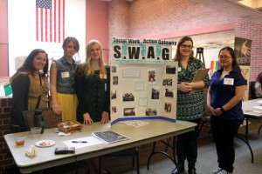
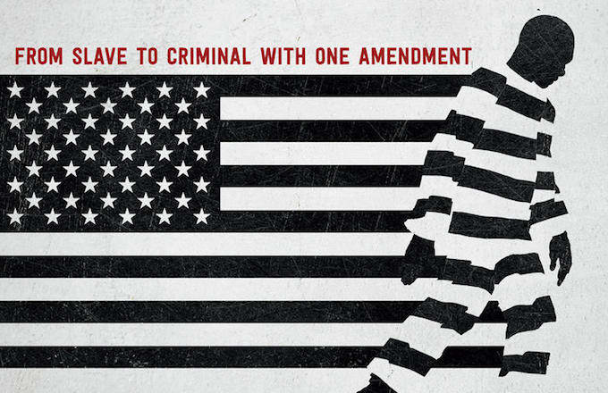
Selected Social Actions
Spreading Awareness through Social Media
Getting involved in social justice movements
Writing letters to individuals in congress
Holding conferences
Building a movement for the social injustice

Slide 16
Question 10
Ethical issues to consider
Grant writing
Available and accessible services
Using technology

Slide 17
Question 11: Relevant Policy Initiatives
LOCAL:
Hampden County Drug Court (PVP, JWJ)
Springfield Public Schools
STATE:
Justice Reinvestment Act (SB64 & HB1469); worked with national organization Council on State Governments (nfp); Bipartisan.
NATIONAL:
(-) Criminalization of Immigration and Poverty; ICE detention centers, and militarization of the border
(+) 12 Grand Challenges - working to introduce legislation to reform criminal justice system; challenge to SWers
INTERNATIONAL:
CERD working group, Stronger collaboration and adherence to UN Human Rights Charter, 92nd Session of CERD currently underway (April 24-May 10, 2017)

Slide 18
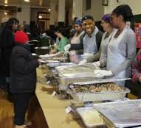
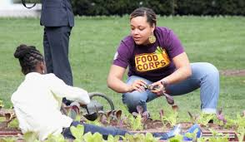
Constructing a Persuasive Argument
Building communities for disenfranchised groups
After school programs
Laws need to be implemented
Soup Kitchens
Access of education

Slide 19
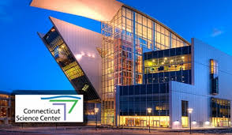
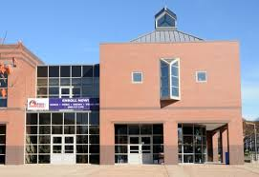
continued ...
The Connecticut Science Program
The Artist Collective
The Blue Hills Civic Association

Slide 20
Question 13: Inducements, Rules, Facts, Rights, Power
Changing behaviors by appealing to
Inducements
Rules
Facts
Rights
Powers

Slide 21
Question 14: Social Action Strategies
Dr. Wronka
Qualitative Research/Quaternary Intervention
“humanize the other”
Creative Dialogue
Gerson & Van Soest: Ghandian Principles
“realization of the maximum potential by every human being” and believed that equality spread beyond social value committing to an “equality [within]… the economic system”
MLK Jr.:
Building a beloved community through authentic and affirming interactions
supporting those most impacted by mass incarceration in their movements to dismantle the system
“direct nonviolent social action might be necessary to implement human rights principles, thereby creating a human rights culture” ( Wronka)

Slide 22
Question 16: Ameliorating Mass Incarceration
Walked in an urban community and offered McDonald's to some underserved members.
Set up a group for youth in Hartford, CT and allowed them to watch a documentary titled “School to Prison Pipeline”.
Two students attended an event put on by Pioneer Valley Project in Springfield, MA that focused on mass incarceration.
Painted a piece of art that focused on an African American man in prison and presented it to students in the Bridges Program at Windsor High School in Windsor, CT.

Slide 23
Question 17
Broaden understanding and negative impacts of mass incarceration
Implementations and interventions
Life-long learning of this phenomenon
Positive feedback

Slide 24
Question 19: Evaluating our Efforts
Challenges:
Broadness of the topic
Time Constraints
Facebook
Political Arena

